Slide 1
Mini Project
Prototype IoT application
SIT314: Software Architecture and scalability for Internet of Things
Zeyu Chen
220289612

Slide 2
51PPT模板网 www.51pp tmoban.com
Content
https://www.ypppt.com/
01
Project Introduction
02
Project Components
GPS data visualization
03
About GPX file
04
Project Architecture
05
Visualisation on Google Maps
06
Information from Google Maps
07
Graphs for analyzations
08
Conclusion

Slide 3
01
Project Introduction
GPS data visualization

Slide 4
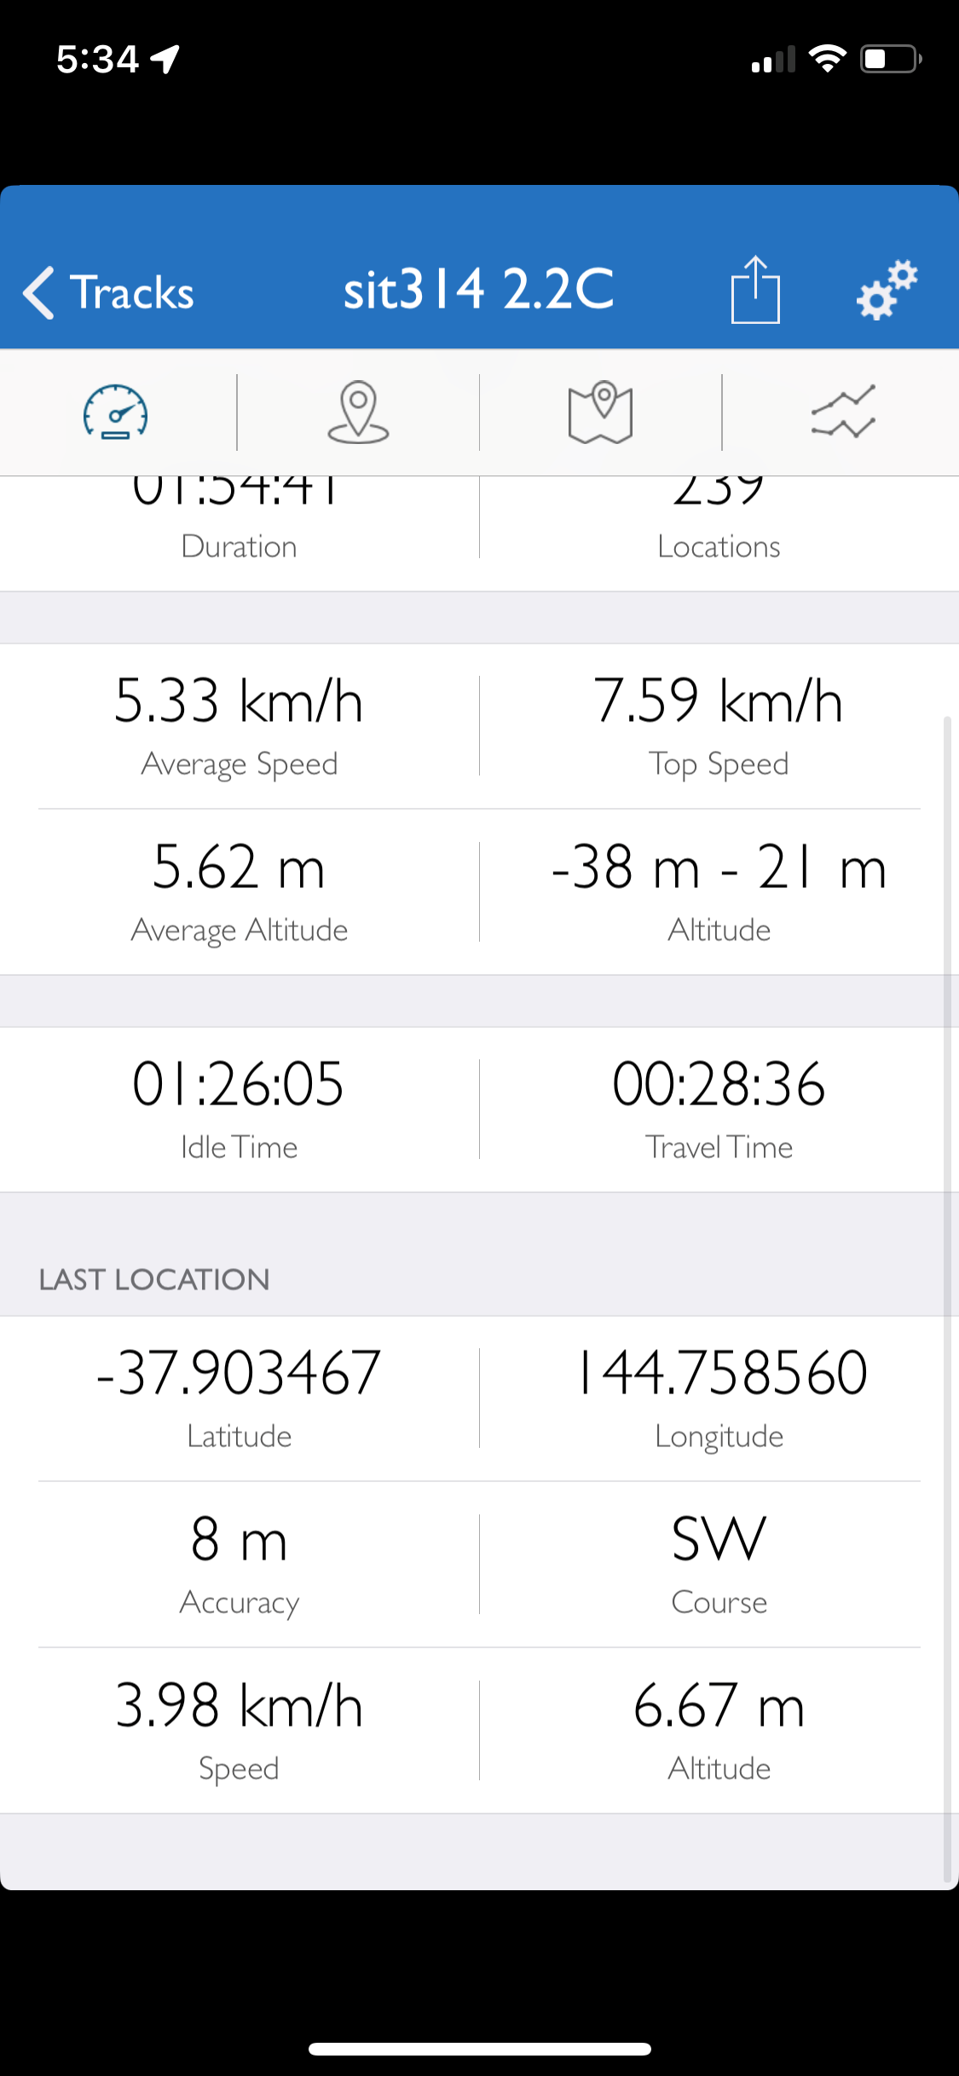
GPS data visualization
Click here to add title text
Within this assessment, I will utilize a smartphone as my end user device to download a GPS data recording application as the name called GPS Tracker. This application will enable the tracking of my movement via GPS data. Subsequently, I will upload the collected GPS data to Google Maps on my laptop as an online GPS visualization and use uTrack as an analyzis tool to conduct further investigation and draw final conclusions.

Slide 5
02
Project Components

Slide 6

Project Component
To complete this task, I needed:
End-User
Network Devide
Cloud Device
Smartphone (with GPS functionality)
Google Drive (used to transmit data to cloud services)
Google map and uTrack in Laptop (used to receive, process and display GPS data)

Slide 7
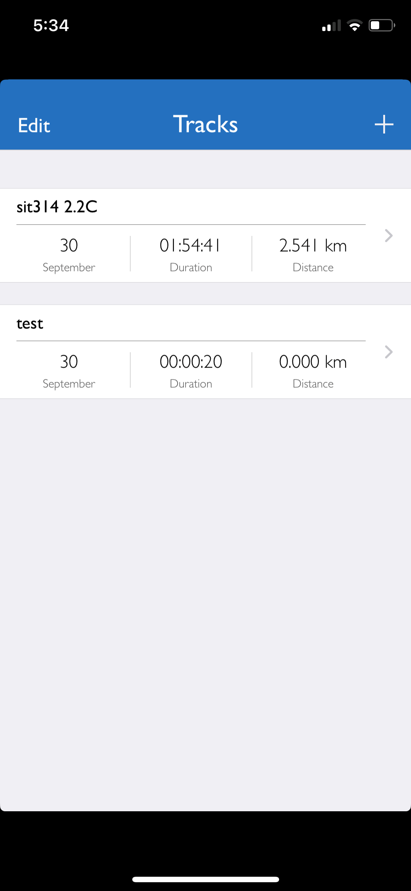
In order to complete this project, I commenced recording from 3:38 PM and concluded at 5:33 PM, totaling approximately 2 hours. The next step involves exporting the GPX file recorded on the smartphone to both Google Maps and uTrack dedicated to visualization services.

Slide 8
03
About GPX file
51PPT模板网 www.51pp tmoban.com
Notes:
https://www.ypppt.com/

Slide 9

About GPX file format
· GPX, which stands for GPS Exchange Format, is a common geospatial data format typically used for storing and exchanging GPS data. It is a text-based file format written in XML, making it easily shareable and perseable across various devices and applications.
· GPX files typically contain the following information:
Track Data: This encompasses information such as longitude, latitude, altitude and date-time recorded by a GPS receiver, along with potential speed and direction data. These data are usally represented in the form of a series of GPS coordinate points and can be used for plotting tracks on maps.

Slide 10
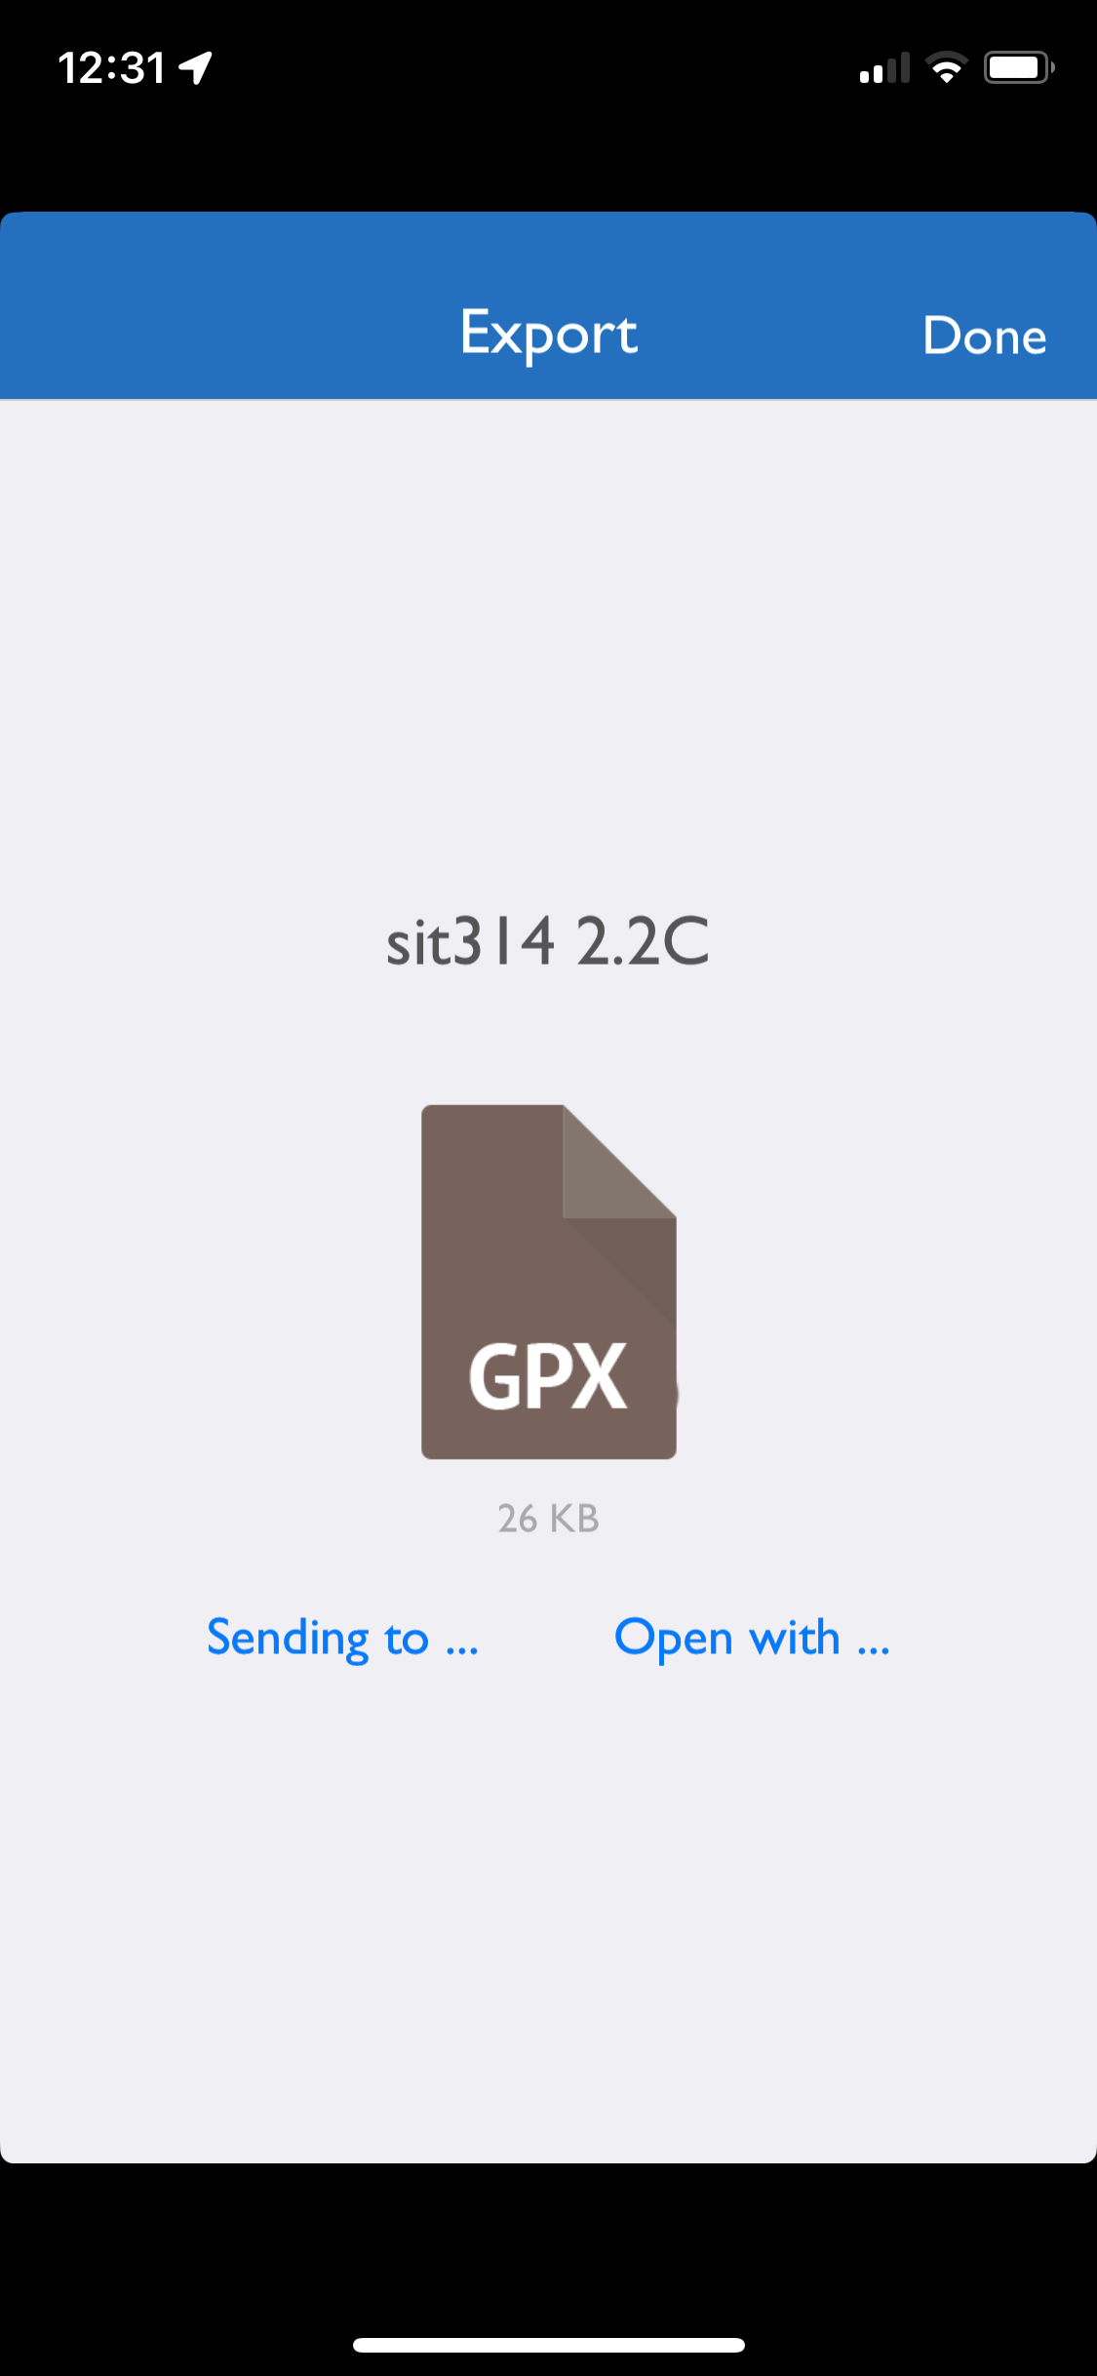
The recorded GPX data for this project has been uploaded to GitHub. Here is the link to the data:
https://github.com/CikkyChen/SIT314_2.2C.git

Slide 11
04
Project Architecture

Slide 12
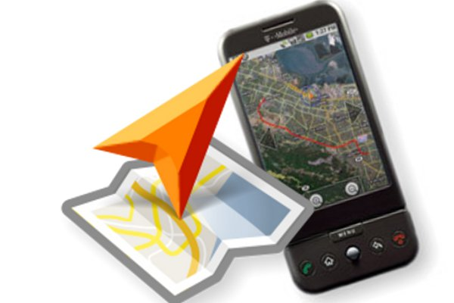
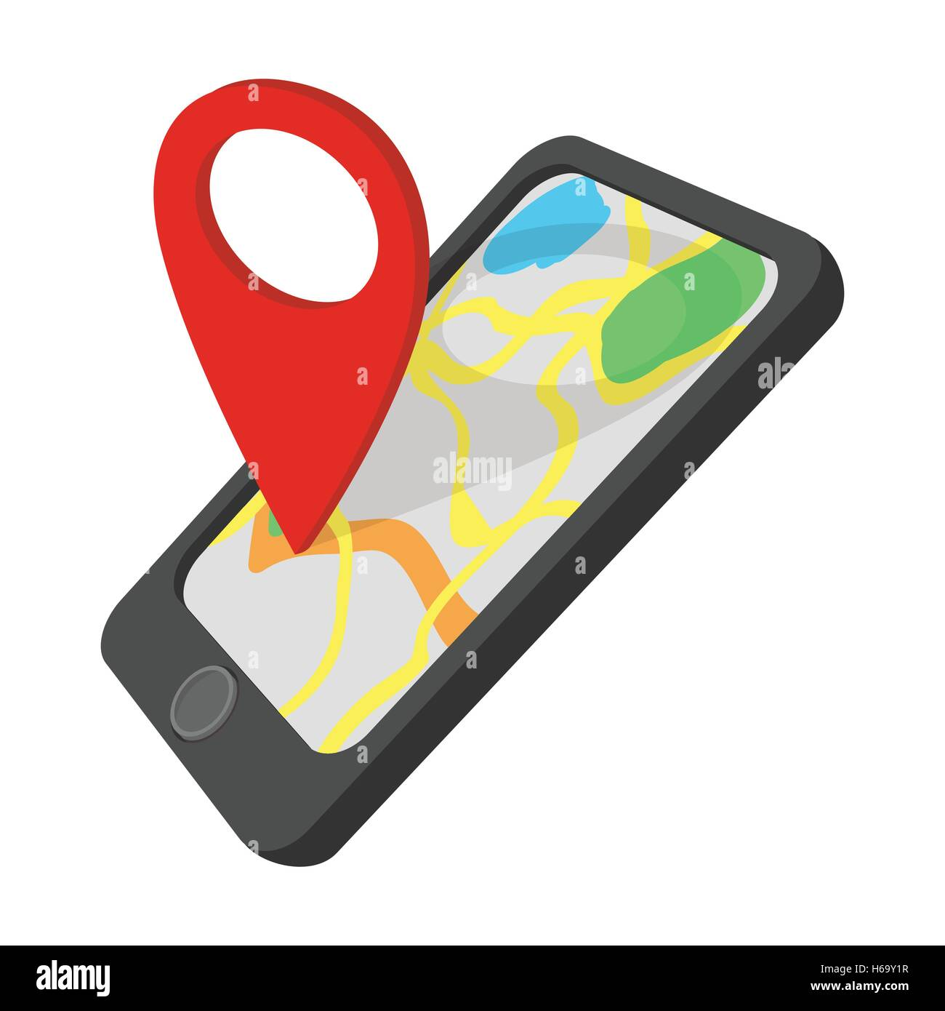
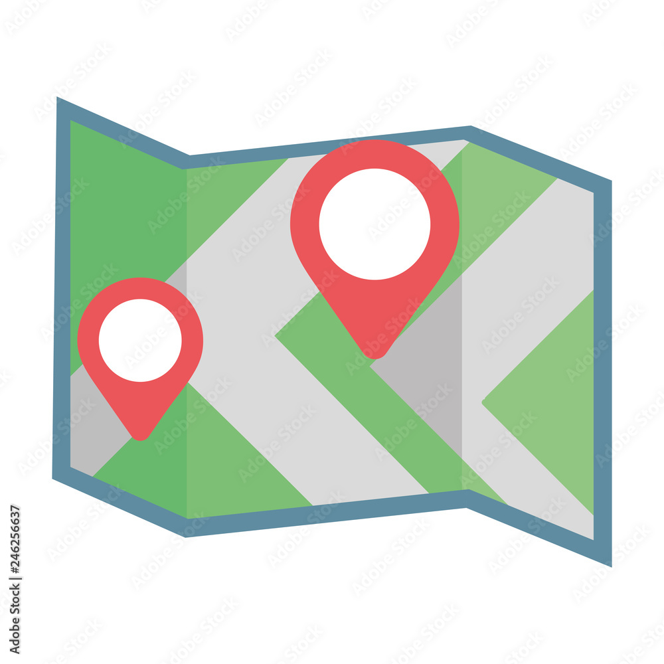
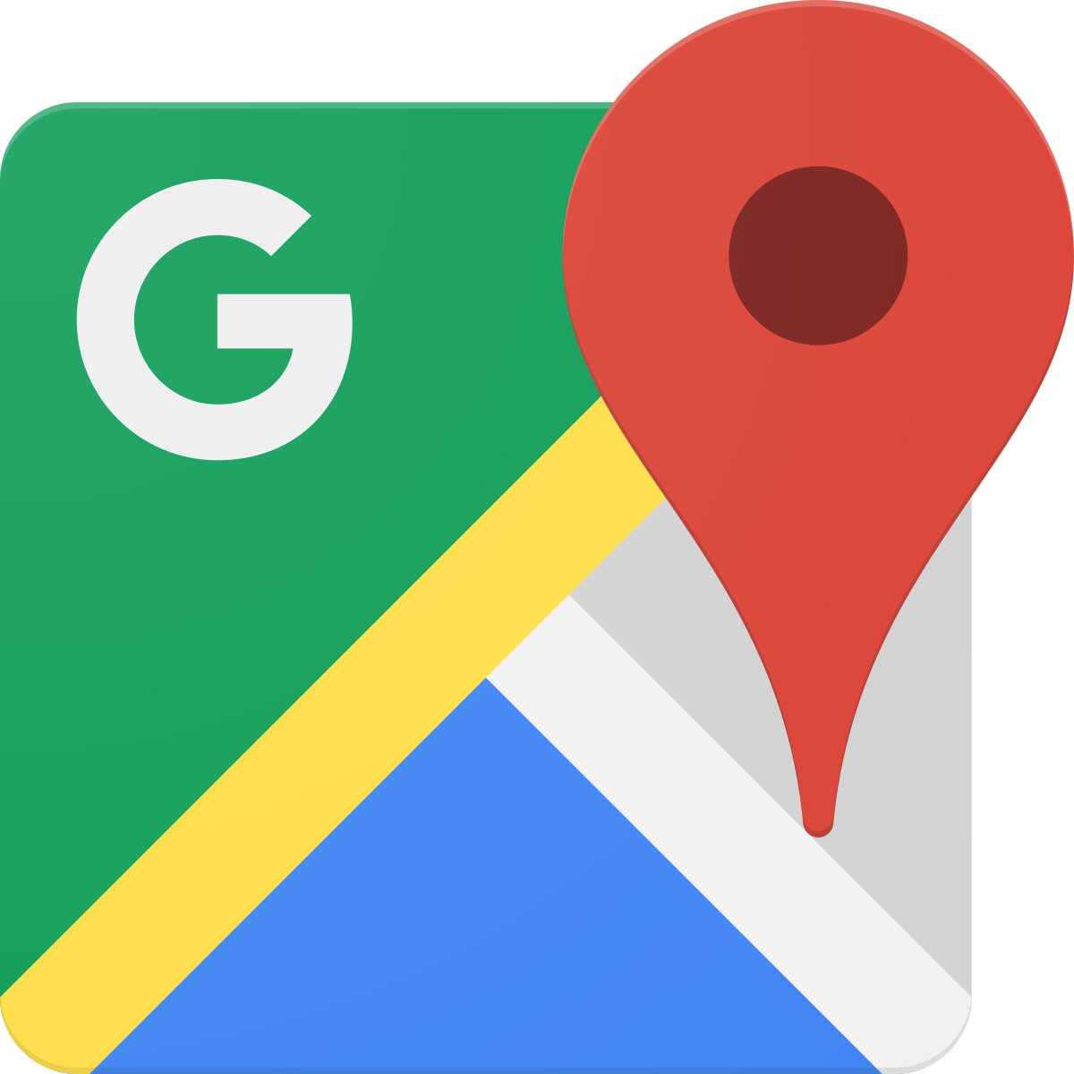
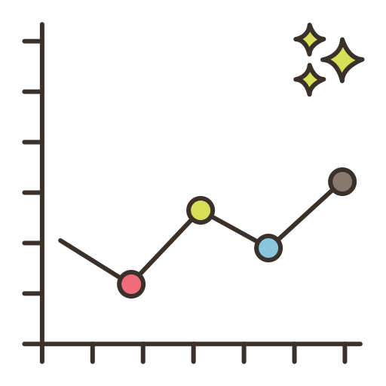
Architecture of the Project
the GPX data will be transmit forwarded to cloud services
Google Maps will act as a cloud service to show the tracks
01
02
03
04
GPS sensors are embedded within smartphone
↑
Smartphone (the end user device) records the data with applicaton
↑
GPX data contains all location information about user
↑
GPS sensor will record the data for the smartphone
The data is recorded on the GPS Tracker and saved in the form of .GPX extension format
uTrack will show all the data information with graphs. For instance: speed, distance and time

Slide 13
05
Visualization on Google Maps

Slide 14
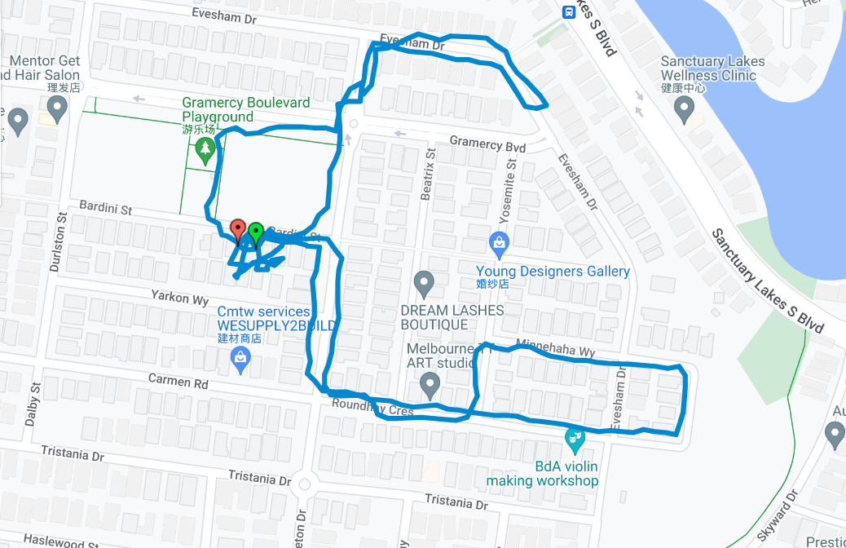
Visualisation on Google Maps

Slide 15
单击此处添加标题文本
Click here to add title text
添加标题
添加标题
添加标题
06
根据自己的需要添加适当的文字，此处添加详细文本描述，建议与标题相关尽量简洁... ...
根据自己的需要添加适当的文字，此处添加详细文本描述，建议与标题相关尽量简洁... ...
根据自己的需要添加适当的文字，此处添加详细文本描述，建议与标题相关尽量简洁... ...
根据自己的需要添加适当的文字，此处添加详细文本描述，建议与标题相关尽量简洁... ...
根据自己的需要添加适当的文字，此处添加详细文本描述，建议与标题相关尽量简洁... ...
根据自己的需要添加适当的文字，此处添加详细文本描述，建议与标题相关尽量简洁... ...
Information from Google Maps

Slide 16
From the displayed track, it can show various information
The map tracking me described provides highly accurate information about my activities during the specified timeframe:
· 3:38, I began recording, while at home working on other assessments.
· 4:46, I left home to take a walk with my dog.
· Due to the hot weather, I decided to return home with my dog.
· 5:13, I arrived back home
· 5:17, I left again and walked around on the park in order to collect more information
· 5:33, I returned home for the second time.
This tracking precisely captures my movements and activities during this time frame.

Slide 17
单击此处添加标题文本
Click here to add title text
添加标题
添加标题
添加标题
07
根据自己的需要添加适当的文字，此处添加详细文本描述，建议与标题相关尽量简洁... ...
根据自己的需要添加适当的文字，此处添加详细文本描述，建议与标题相关尽量简洁... ...
根据自己的需要添加适当的文字，此处添加详细文本描述，建议与标题相关尽量简洁... ...
根据自己的需要添加适当的文字，此处添加详细文本描述，建议与标题相关尽量简洁... ...
根据自己的需要添加适当的文字，此处添加详细文本描述，建议与标题相关尽量简洁... ...
根据自己的需要添加适当的文字，此处添加详细文本描述，建议与标题相关尽量简洁... ...
Graphs for analyzations

Slide 18
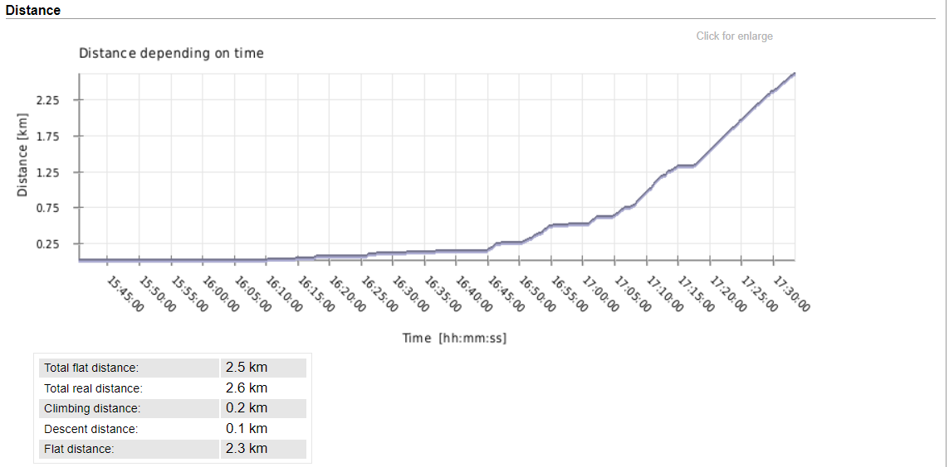
First I am going to analyze the graph distance vs time
From the graph, it is evident that I remained at home for nearly an hour initially, as indicated by the flat and steady trajectory on the graph. Then, I began walking again, leading to a consistent increase in distance.

Slide 19
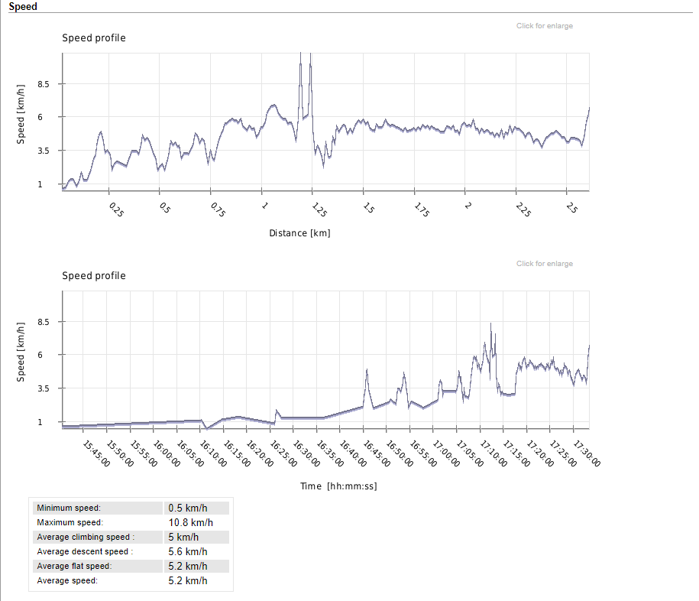
The graph in this slide depicts the relationship between speed with distance and time
The first chart illustrate the speed vs distance. It displays the speed throughout the journey form the starting point to endpoint.
The second chart displays the speed vs time. From the chart, it is evident that initially, my speed was low while I was at home, indicating that I was not moving quickly. Later on, there is peak in speed, suggesting that I reached my maximum speed at that point.
The peak speed in the graph also indicates that I totally relined on walking throughout the entire journey and did not use any transportation.

Slide 20
单击此处添加标题文本
Click here to add title text
添加标题
添加标题
添加标题
08
根据自己的需要添加适当的文字，此处添加详细文本描述，建议与标题相关尽量简洁... ...
根据自己的需要添加适当的文字，此处添加详细文本描述，建议与标题相关尽量简洁... ...
根据自己的需要添加适当的文字，此处添加详细文本描述，建议与标题相关尽量简洁... ...
根据自己的需要添加适当的文字，此处添加详细文本描述，建议与标题相关尽量简洁... ...
根据自己的需要添加适当的文字，此处添加详细文本描述，建议与标题相关尽量简洁... ...
根据自己的需要添加适当的文字，此处添加详细文本描述，建议与标题相关尽量简洁... ...
Conclusion

Slide 21
Applications used while completing project
· GPS Tracker
https://apps.apple.com/app/id984920064
· Google Drive
https://drive.google.com/
· Google Maps
https://maps.google.com/
· uTrack
http://utrack.crempa.net/

Slide 22
Conclusion
The GPS sensor embedded within the smartphone operates in conjunction with a mobile application, in my case, employing the GPS Tracker application for this purpose. The smartphone serves as the end user device and it will record the user’s track until the user has stopped the recording and it will be saved as a GPX file. The GPX file will output the various information of the user. Moreover, these data will send to cloud services like Google Maps which will analyze the track of user on map, and uTracks which will provide graphical representations of data. For instance, speed; distance and time etc.

Slide 23
Thank you so much for watching

